Slide 1
Digital Pass Wallet Project progress presentation
Name: Diyan Komitov
Supervisor: Dr Sotirios terzis
Second Marker: Dr Matt-Mouley bouamrane

Slide 2
Overall Aims and goals
To create an Android application for managing digital passes (tickets).
To improve upon currently available apps such as Apple Wallet (for iOS) or Pass2U (for Android).
To learn to develop for mobile and Android in particular.
To create an app for actual use by the general public and not just for the purposes of the project.

Slide 3
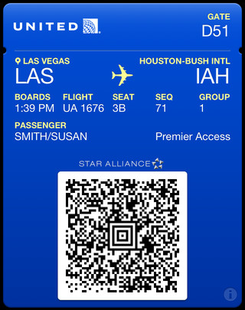
What Is a digital pass
Logo
Header Field
Primary Field
Auxiliary Field
Secondary Field
Barcode

Slide 4
Project specification and requirements
The application should be able to display digital passes.
The user should be able to add passes in one of three ways.
Opening a PKPass format file.
Downloading a pass via QR code.
Creating a pass manually by filling out a form.
In this case the barcode can either be generated manually, or
Scanned and copied, or
Copied from an image.
The application should display a lock screen notification, if appropriate, near specified times and locations.
The application should be able to handle NFC based passes (such as underground cards).
The application should store passes between sessions.
The user should be able to share passes with others.
The user should be able to sort and categorise passes based on different criteria.
The user should be able to customise, edit and delete passes.
Passes should update automatically, if appropriate.

Slide 5
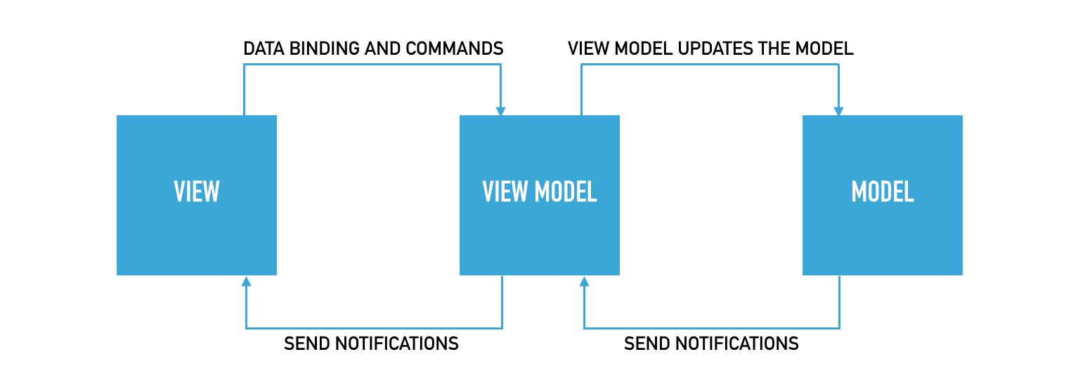
design
Not finalised and will change as development continues.
Current plan is to use a Model-View-ViewModel (MVVM) architecture.
Rational behind this is that it seems to be very well integrated within Android.

Slide 6

Model-View-ViewModel
The Model exposes necessary data, but does not know or care who sees it. It also notifies whomever is listening when it is changed.
It consists of Pass objects, JSON parser, file reader, image loader, barcode generator, any potential database and other utility classes and methods.
The View is the representation of the model that the user sees and interacts with. However it only interacts with the ViewModel and has no knowledge of the Model itself.
It consists of the Activities, Fragments, Views and their layout (XML) files.
It uses Data Binding to interact directly with the ViewModel inside the XML files.
The ViewModel acts as an interface between View and Model and translates the Model for the View. It only knows about the Model and not the View.
It exposes observable data as well as commands that the view can use via data binding.
It updates the model when requested by the view.

Slide 7
Work done so far
Requirements Gathering Survey
60% of participants used Android of which only 28% had used a similar app.
40% of participants were using iOS of which 59% have used Apple Wallet.
Only 20% of participants would not use a similar app in the future.
The main reasons given were that they prefer using physical tickets or that they can use the tickets they receive in an email.
Ease of use was deemed the most important feature, while Notifications near a specified location the least important.
NFC cards were deemed the most important feature narrowly beating Boarding cards, followed by Event tickets.

Slide 8
Work done so far
Prototype
Created basic backend with Pass objects.
Created JSON parser that parses the PKPass JSON file and creates a Pass object from it.
Created basic app layout and Pass views.
Put together a prototype.

Slide 9
Evaluation plans
The current evaluation plan is to conduct usability tests on the finished app.
The aim would be to get between 15 and 20 participants.
They would be asked to perform certain tasks with the app while being observed and notes will be taken regarding how well they do and if they struggle.
Afterwards they will be given a questionnaire to fill out, perhaps something like a system usability scale, which will show how they felt about the experience.
The results will be evaluated to determine if the project was successful.
Planning to have one week dedicated to evaluation upon completion of development.

Slide 10
Overall Plans
Currently on track with original plan.
Immediate next steps are to implement all components of the Pass view, such as the back of the pass, after that to figure out pass storage through a database or otherwise. Then work on barcode scanning and copying.
Thinking of using Trello to organise project.
Furthermore I am going to start writing parts of the report such as the background study.
Aiming to be finished with the development by the 1st of March so that there is enough time for testing and evaluation.

